Slide 1
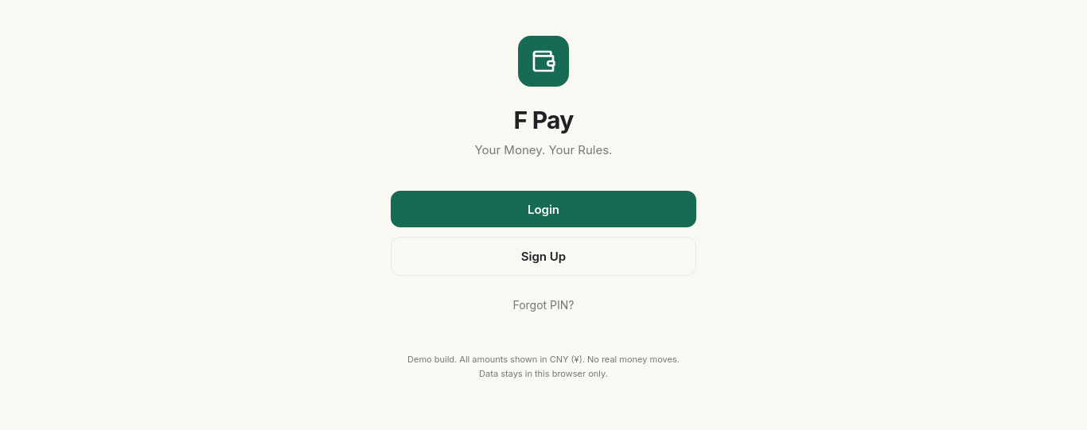
F PAY
Name
Department Course Number Section Time Location
DATE
Your Money. Your Control. Your Security.
Rethinking Digital Wallets Through Financial Awareness and Transaction Protection
FinTech · Digital Wallet Security · Transaction Risk Awareness

Slide 2

The Problem We Want to Address
Name
Department Course Number Section Time Location
DATE

Slide 3
Name
Department Course Number Section Time Location
DATE
01
Unexpected or unplanned spending
Our question
02
Limited organization of money by purpose
Can a wallet help users make more informed decisions before a transaction proceeds?
03
Transactions that conflict with a user's budget
04
Unauthorized access and potential financial fraud
05
Transfers made under pressure or coercion

Slide 4
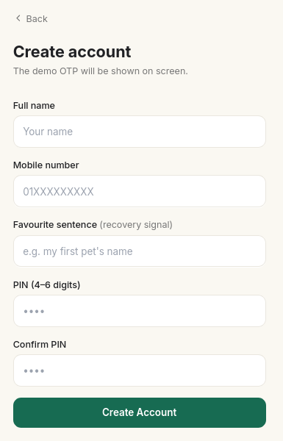
Name
Department Course Number Section Time Location
DATE
Introducing F Pay
A Protective Digital Wallet Framework

Slide 5
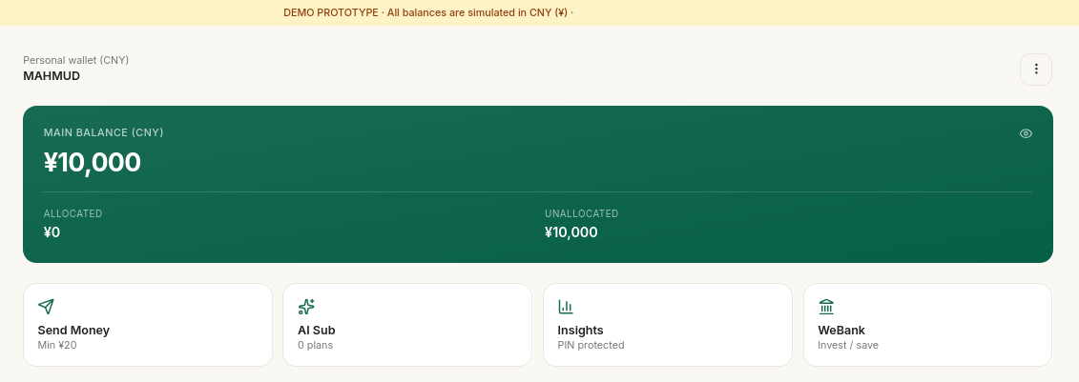
Name
Department Course Number Section Time Location
DATE
Purpose-based virtual money management
Budget-aware transaction review
Security-oriented workflows
A modular architecture for future development
ORGANIZE → UNDERSTAND → REVIEW

Slide 6
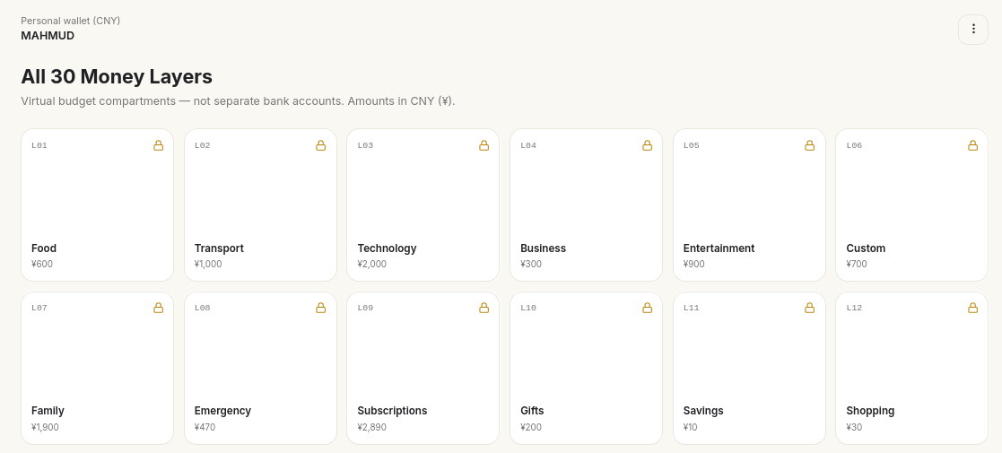
Name
Department Course Number Section Time Location
DATE
Our Core Concept: 30 Virtual Money Layers
Instead of viewing all available funds as one undifferentiated balance, users can organize allocations around their financial priorities.

Slide 7
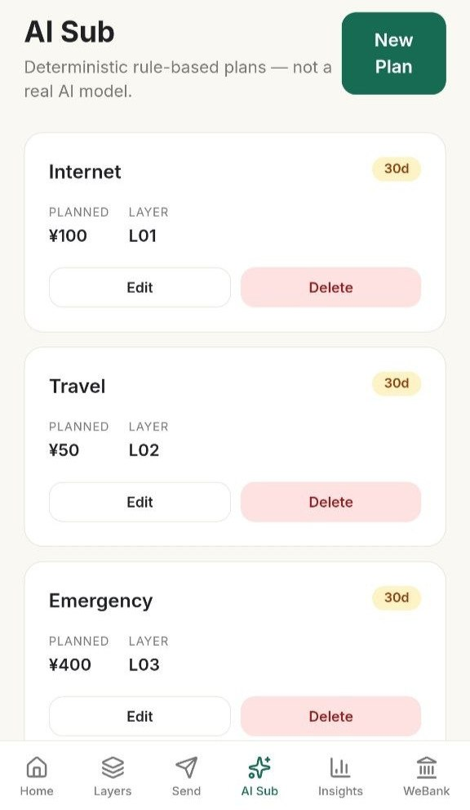
Name
Department Course Number Section Time Location
DATE
AI Sub: Purpose-Aware Budget Intelligence
Text Callouts 16
From Spending Records to Better Financial Awareness
Create purpose-based spending plans
Compare planned and proposed amounts
Identify budget discrepancies
Summarize planned versus recorded spending
Explore more advanced analytics in future phases

Slide 8
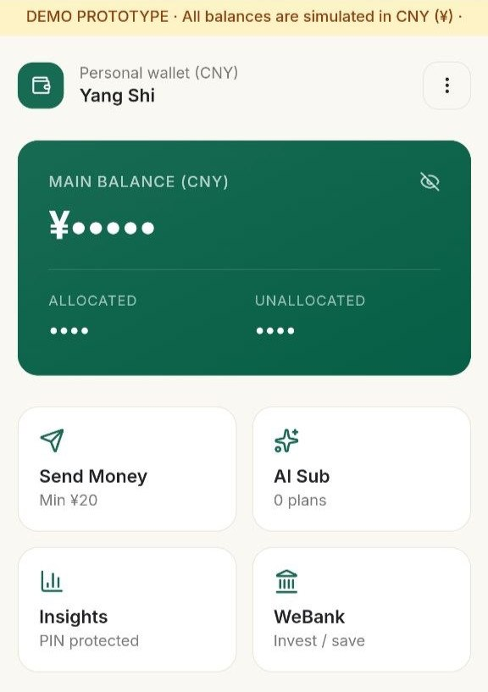
Phase 1: What We Have Built
Name
Department Course Number Section Time Location
DATE
From Idea to Prototype
Initial wallet interface
30-layer money-management concept
Prototype-level access and transaction workflow
Exploration of budgeting and review features
Foundation for the next development phase

Slide 9
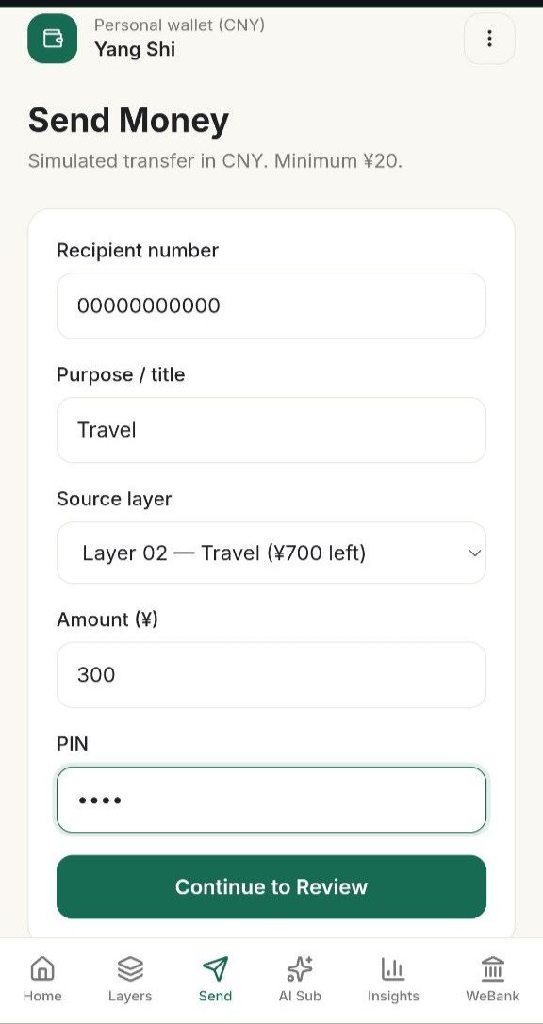
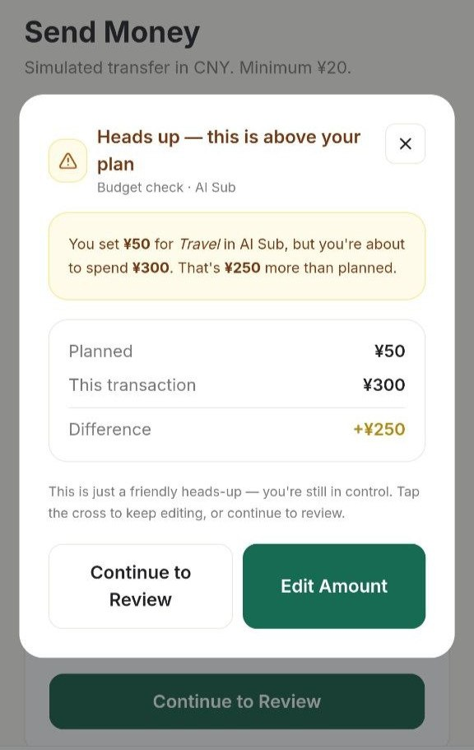
Live Demo
Name
Department Course Number Section Time Location
DATE

Slide 10
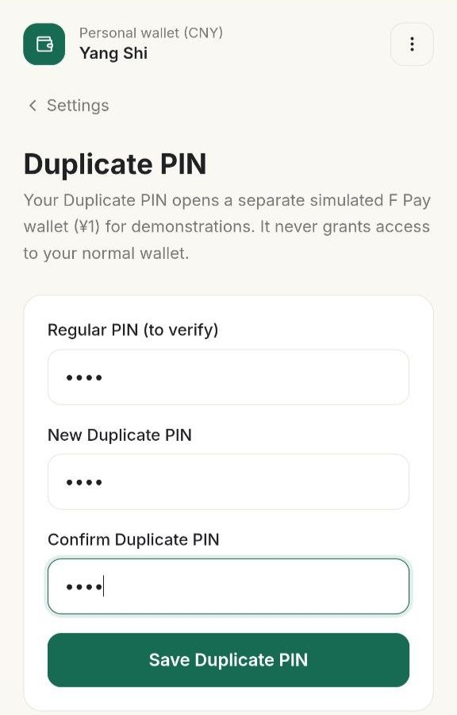
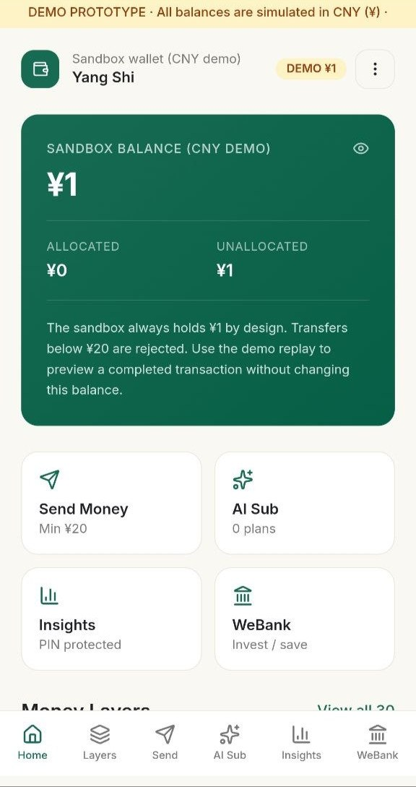
DUPLICATE PIN — EMERGENCY SAFETY MODE
Name
Department Course Number Section Time Location
DATE
Under threat, robbery, or forced-transfer situations, a separate PIN opens an isolated decoy wallet with a small demo balance and fictional activity, designed to reduce exposure of the primary wallet.

Slide 11
Phase 2: Our Proposed Technical Architecture
LAYER 1 — FRONTEND
React / Next.js / Tailwind CSS
↓ HTTPS / REST API
LAYER 2 — BACKEND
Python / FastAPI
Authentication · Wallet · Budget Logic · Transaction Review
↓ SQLAlchemy
DATABASE — PostgreSQL
Users · Layers · Budgets · Transactions · Audit Logs
↓ Optional Verification
LAYER 3 — BLOCKCHAIN
FISCO BCOS / Solidity
Record Verification
FLOW: User → API → Backend → Database → Blockchain

Slide 12
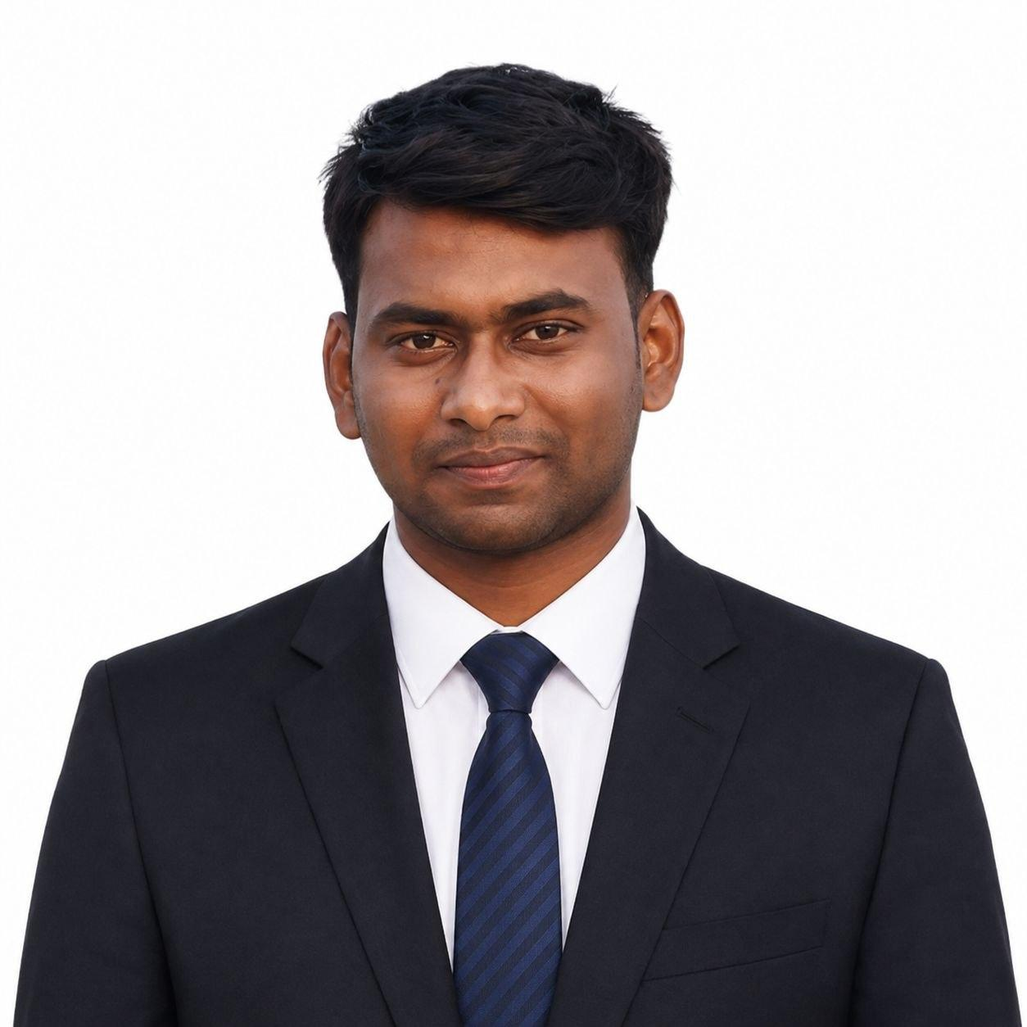


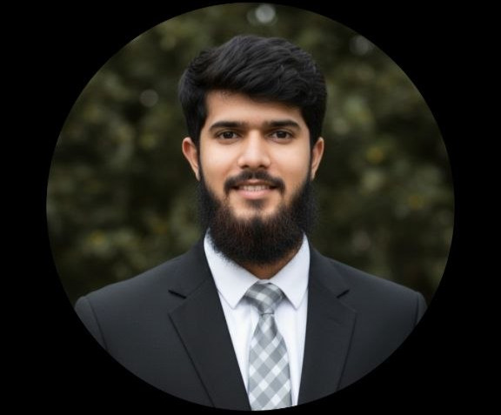
Meet Our Team
Name
Department Course Number Section Time Location
DATE
Md. Tohidul Islam Nahid
Team Lead & Core Solutions Architect
Najmun Nahar Hira
Frontend & Interactive Web Developer
Hosnatul Ferdous
Pitch Specialist & Financial Product Analyst
R.H.M Romim
Media Producer & Technical Documentation Lead

